Slide 1
Project Presentation On Library Catalog Management System
Sumaiya Alam Ananna
Roll: 1909041
Dept: Electronics And Communication Enginnering
Year: 3rd
^{Semester:2nd}

Slide 2

Project: Library Catalog Management System
Library Management System deals with the management of books and member details in the library.
It facilitates the borrowing and returning of the books within the organization staffs.
Here Employee should have login to authentication system.
Readers are divided into free readers and paid readers
Create an easy to understand user friendly environment.

Slide 3
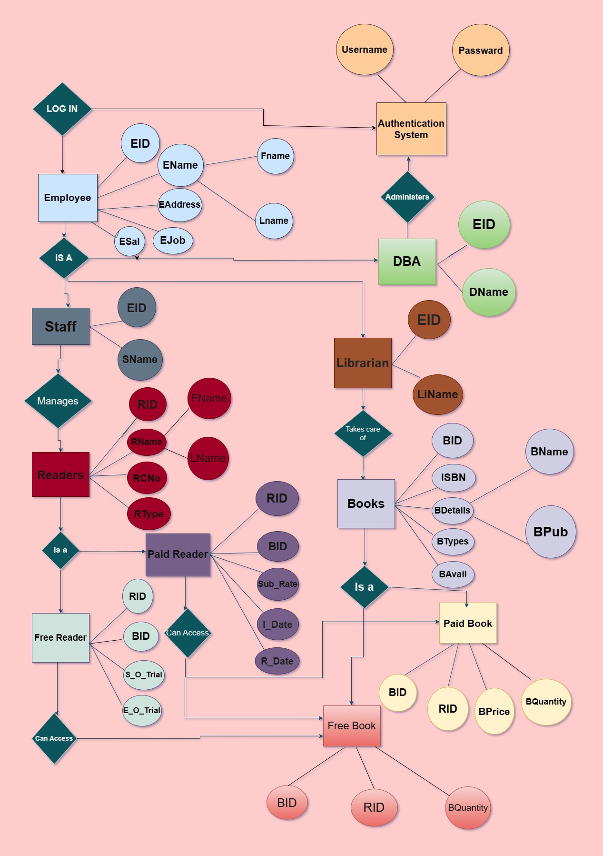

Slide 4
Table For Employee
EID | FNAME | LNAME | EAddress | EJOB | ESAL
E001 | Faraz | Ahmed | Khulna | Librarian | 10000
E002 | Kabir | Karim | Khulna | Librarian | 10000
E003 | Anita | Ahmed | Dhaka | Staff | 15000
E004 | Faysal | Islam | Dhaka | Staff | 15000
E005 | Sagor | Khan | Dhaka | Staff | 15000
E006 | Maliha | Khan | Barisal | DBA | 30000
E007 | Maria | Khan | Khulna | DBA | 30000

Slide 5
Table For Readers
RID | FNAME | LNAME | RCNO | RTYPE
R001 | Sumaiya | Alam | 01705723393 | Free
R002 | Faria | Rafa | 01704567832 | Paid
R003 | Bushra | Saima | 01704567834 | Paid
R004 | Borno | Mirza | 01704567543 | Free
R005 | Zarrar | Ayaan | 01704567450 | Paid
R006 | Alvi | Ayon | 01704567509 | Free

Slide 6
Table For Books
BID | ISBN | BName | BPUB | BType | BAvail
B001 | 9780 | Com_System | Wiley | Paid | Yes
B002 | 2345 | Micro_Cirt | Oxford | Paid | Yes
B003 | 2374 | Digital_Pres | Pearson | Paid | Yes
B004 | 2309 | Electromag | W._Company | Free | Yes
B005 | 4567 | Electronic_Cir | Pearson | Paid | No
B006 | 4237 | Digital Comm | Wiley | Free | No

Slide 7
Table For Staffs
EID | SNAME
E003 | Anita
E004 | Faysal
E005 | Sagor

Slide 8
Table For Librarian
EID | liName
E001 | Faraz
E002 | Kabir

Slide 9
Tble For DBA
EID | DName
E006 | Maliha
E007 | Maria

Slide 10
Table For FreeReader
RID | BID | S_O_Trial | E_O_Trial
R001 | B004 | 2023-04-25 | 2023-05-25
R004 | B006 | 2023-03-28 | 2023-04-28

Slide 11
Table For PaidReader
RID | BID | Sub_rate | I_Date | R_Date
R002 | B001 | 150 | 2023-02-28 | 2023-03-28
R003 | B002 | 200 | 2023-01-08 | 2023-02-08
R005 | B003 | 250 | 2023-04-08 | 2023-05-08

Slide 12
Table For FreeBook
BID | RID | BQuantity
B004 | R001 | 10
B006 | R006 | 15
B004 | R004 | 18

Slide 13
Table For PaidBook
BID | RID | BPrice | BQuan
B001 | R002 | 250 | 10
B002 | R003 | 150 | 15
B003 | R005 | 270 | 20
B005 | R002 | 130 | 15

Slide 14
Table For Authentication
UserName | Password
AN_A | ECE
KA_R | ECE
FA_Z | ECE
SA_R | ECE
MA_A | ECE

